Slide 1
OpenShift on AWS workshop
Openshift.awsworkshop.io
https://<Add workshop bucket name here >.s3-us-west- s3-us-west-2.amazonaws.com/workshop.html 2.amazonaws.com/workshop.html
Ryan Niksch - AWS - Snr Solutions Architect

Slide 2
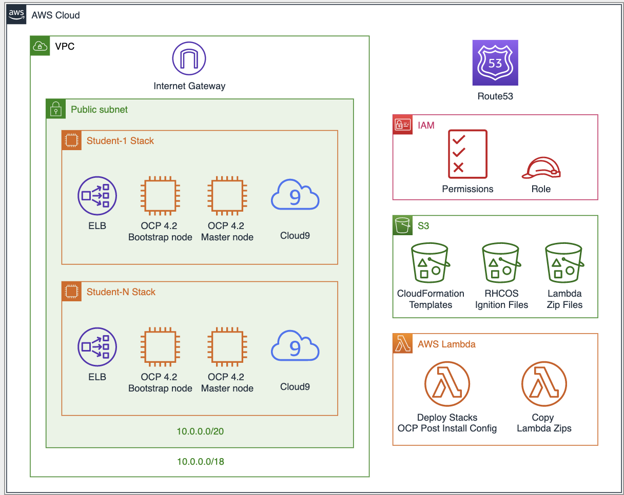
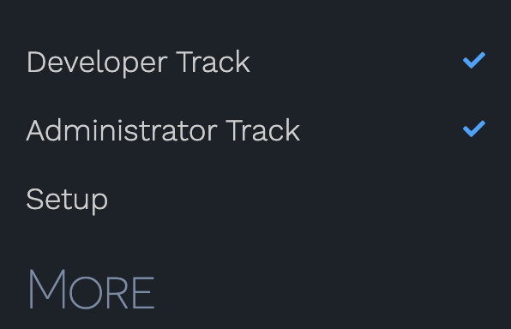
About this workshop
https://github.com/rniksch/Openshift4-lab-launcher.git
Developer, administrator, Cloud center of excellence, and security topics.
Self Paced, Self Service, optional modules.
Customizable
Notes:
The workshop technical assects are deployed using AWS CloudFormation and Lambda functions to generate ignition files needed for the OpenShift installer, and repeatedly deploy clusters. Each attendee gets their own OpenShift cluster running on AWS as well as a Cloud 9 Dev env.
This is not a production implementation this is a single instance deployment all nodes are on the same EC2 instance

Slide 3
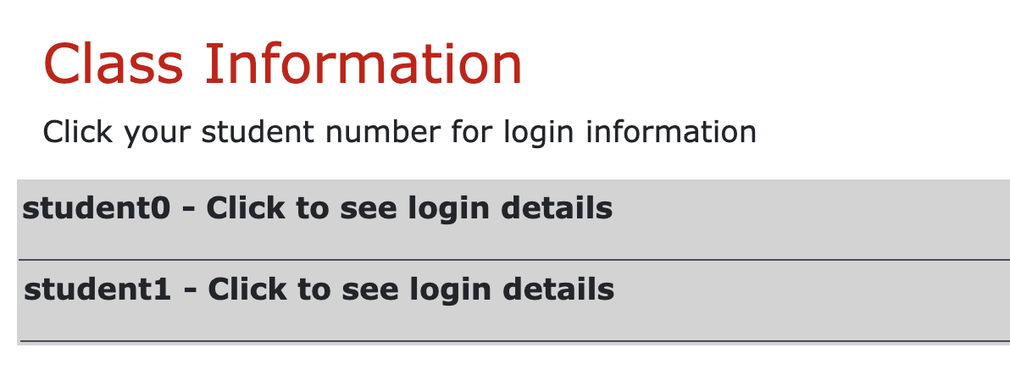
Getting you hands dirty
The Workshop:
openshift.awsworkshop.io
Select a track
Complete getting started
Mix and match your topics
Connect to your systems:
https://<Add workshop bucket name here >.s3-us-west- s3-us-west-2.amazonaws.com/workshop.html 2.amazonaws.com/workshop.html
Each attendee will be provided a Student number.

Slide 4
Notes to presenter
The presentation has a topics page and links to allow you to jump around and focus on topic relevant to the audience.
This allows you to run through the entire workshop time permitting, or touch specific topics or jump around following where the audience takes you.
Attendees can run through the labs at their own pace, select which labs they want to do or follow along.
As the presenter you can choice to run through a specific track, or touch on specific labs.

Slide 5
Topics
Better together
Customer Story
OpenShift abstractions
OpenShift versions
Modernization phase 3
OpenShift Architecture
Deploying OpenShift on AWS
Migrating to AWS
Cost Management
Comparing apples with apples

Slide 6



A Modern Digital Business
Business Agility
Access to Insights
Modern Digital Business
Operational Efficiency
Technical Resiliency
© 2019, Amazon Web Services, Inc. or its Affiliates. All rights reserved. Amazon Confidential and Trademark

Slide 7




BUSINESS IS CHANGING
Organizations need to develop and deploy applications quickly, reliably, and flexibly
55%
49%
47%
41%
are automating and orchestrating IT systems and processes¹
are delivering applications from cloud environments¹
are changing how they develop applications¹
are exploring new application architectures¹
1 F5 Networks, “The State of Application Delivery 2018 Report,” 2018.
Notes:
Organizations face increased pressure to develop and deploy compelling applications more rapidly, reliably, and flexibly.
55% of organizations are automating and orchestrating IT systems and processes
49% are delivering apps from the cloud
47% are changing how they develop applications
41% are exploring new app architectures like containers and microservices
[F5 Networks, “The State of Application Delivery 2018 Report,” 2018. https://f5.com/about-us/news/the-state-of-application-delivery]

Slide 8
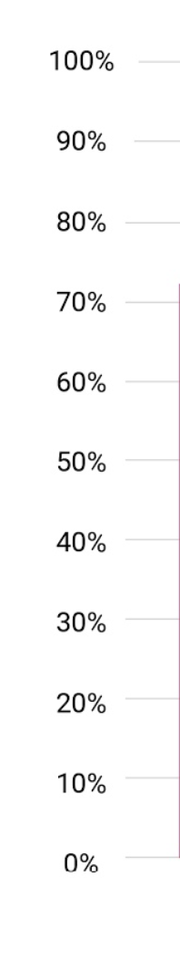
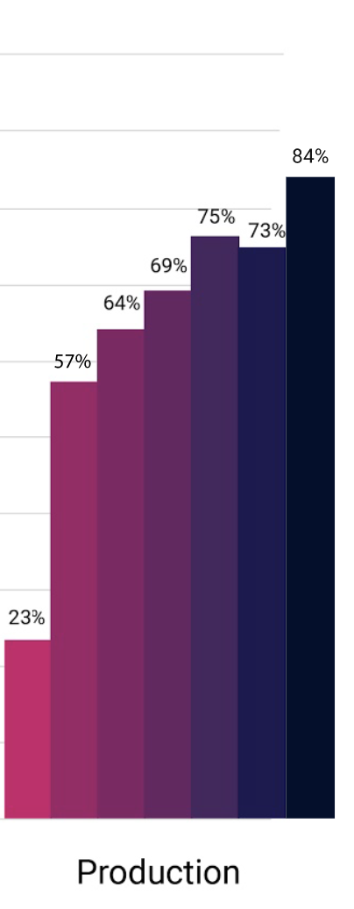
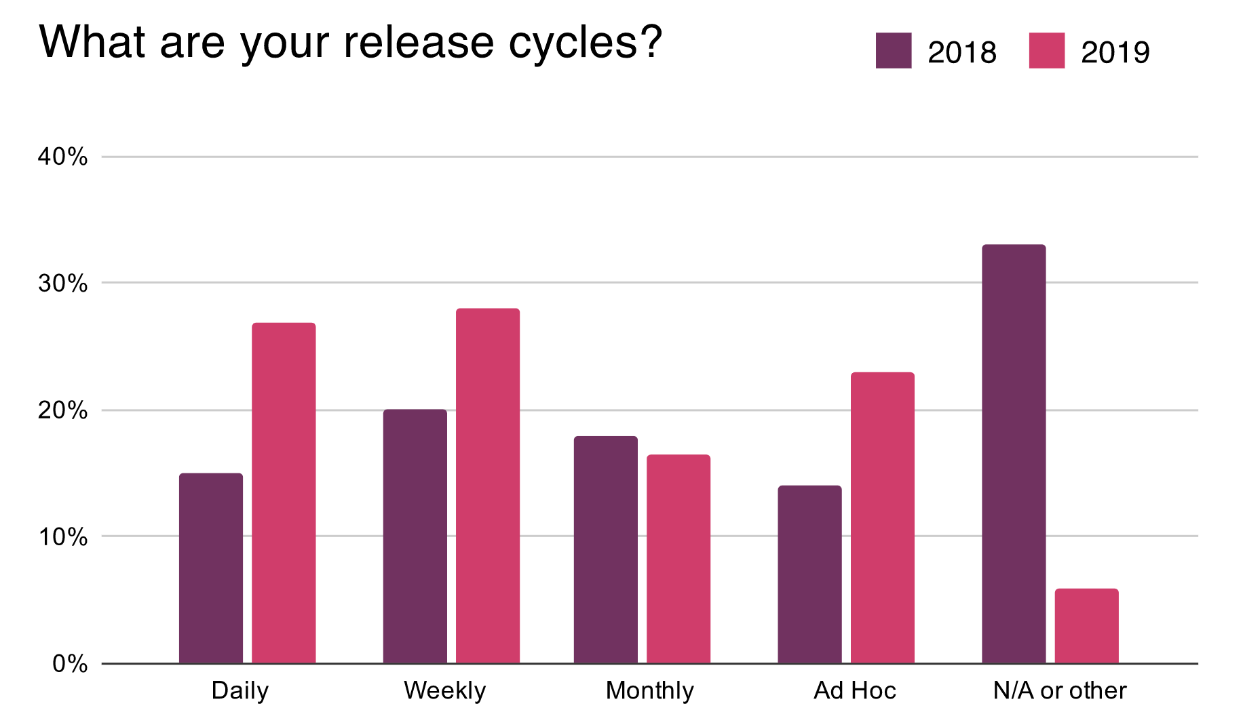
Production Container use 84%
Daily and weekly releases are the new norm
https://www.cncf.io/blog/2020/03/04/2019-cncf-survey-results-are-here-deployments-are-growing-in-size-and-speed-as-cloud-native-adoption-becomes-mainstream/

Slide 9
Why Customers are selecting OpenShift on AWS.
Elasticity
Scalability
Availability
Service Portfolio
Security
Cost
Notes:
Hybrid use case ( Unified experience ):
Customers have a desire to have the same developer and operation process, experience and interfaces for both on prem as well as cloud : agility through familiarity.
Turn Key Solution:
OpenShift provides the features of several AWS services in a turn key solution.
Prescriptive security:
OpenShift provides not only the tools and options for security but also a prescriptive guard rail approach on how to implement these.
Abstractions:
OpenShift provides abstractions on several layers to simplify and accelerate the role of developers and operators.
Agility:
All the above aggregate resulting in increased developer productivity, increased operational efficiency, and faster time to market.
These are the typical cloud value props we will see these with every discussion regarding why do customers move from on premises to the cloud.
Customers have provided feedback that they are moving their OpenShift implementations to AWS for various reasons:
Availability :
Though OpenShift itself caters for resilience and application availability it still runs on top of other infrastructure layers.
Customers have moved to AWS as they can achieve greater availability on AWS than in their existing data centers.
Making use of AWS Regions customers can reach a more global target market without investing in data centers in those locations.
AWS availability zones become a part of this discussion.
Availability goes beyond AWS as a IAAS provider, customers are modernizing their applications and are attracted to consuming AWS native services which are build from the ground up to cater for resilience out of the box. i.e instead of a customer having bother with how to architect, implement and maintain a database in a high available manner, they could simply use AWS RDS.
It is these services which combine with the customer applications running in OpenShift which are highly attractive.
Elasticity and Scalability:
Yes many customers are running an automated virtualization stack such as vmware or other on premises.
Yes they can scale to a degree.
Customers con only scale within the confines of their infrastructure investment before leading into costly (CAPEX ) and longwinded procurement cycles, on then result in administrative and operation overheads (OPEX)
The ability to provision, scale and manage all resources instantly via APIs is also desired by customers.
Again this is not limited to the IAAS features but also the native services. AWS provide services which scale automatically to meet the needs of the customer, S3, DynamoDB, SQS, SNS, etc.
Security:
At AWS security is priority 1!!!
All systems services and processes are build with security in mind.
Comprehensive list of compliance certifications,
Large collection of tools and services to allow customers to secure their business at various layers.
Rich list of customer who trust AWS for their sensitive and critical workloads.
Cost:
Service cost reductions
Reserved instances
Spot instances
Savings plans
Consumption based pay as you use and only what you use model.
Rich cost tracking tools set
Rich feature and service set:
Instead of customers re inventing the wheel or investing time effort and resources into solving complex problems, they can take advantage of a rich set of AWS services and features which are rapidly expanding.

Slide 10
OpenShift on AWS, better together!

Slide 11


Customer Success
https://www.brighttalk.com/webcast/15137/381792/aws-case-study-how-scholastic-embraced-devops-microservices-and-containers
https://aws.amazon.com/solutions/case-studies/scholastic/
https://aws.amazon.com/solutions/case-studies/cathay-pacific-airways/
https://www.redhat.com/en/success-stories/cathay-pacific
https://scrumorg-website-prod.s3.amazonaws.com/drupal/2018-09/Cathay-Pacific-Airways_Sept2018.pdf
https://pages.awscloud.com/apn-tv-other-ep-049.html?trk=tv_card&did=tv_card

Slide 12
Scholastic Challenges
Hundreds of monolithic applications
Inconsistent infrastructure practices
Monitoring and alerting inconsistency
Average go-live for application was 2-3 months
Notes:
Back in 2016 we faced some notable challanges. Scholastic had hundreds of monolithic application and infrastructure set ups. By now most of us know the negatives of monolithic architectures from application standpoint, but there is a lot of overhead from infra side of it as well. The infrastructure was hard to manage and we did not have any consistency. Some of it was deployed and updated manually while others automated with tools like Chef. It was hard to keep track of environments and there was inconsitencies. Some apps had dev qa perf stage while others just had qa and prod. There was also the issue with monitoring since each team managed their own set up with various tools.
One of the biggest issues was the time it took for an application to go live. Back then it was about 2 to 3 months depending on the size of the app. Deployments took long because each environemnt had to be built out and then deployments were done by operations. Operation readiness, which for Scholastic meant going through application architecture with the operations team and making sure monitoring was in place, took up to 2 weeks.

Slide 13
Why Scholastic Choose Red Hat (on AWS)
We evaluated vanilla Kubernetes, Tectonic, and OpenShift Origin.
Finally settled on OpenShift Enterprise because:
Source to Image (S2I)
Routes
Templates
Orchestration and Installation
Friendly user interface
Support
Notes:
Raw Kubernetes was in its infancy back then and came with a lot of overhead bits and pieces. It was difficult to manage install and manage. Compared to OpenShift, the UI just wasn’t as friendly to beginners. Tectonic impressed us with its ”one click install” option but at that point we were already doing dev work on Openshift and had mostly settled on it.
Openshift offered S2I, which we thought would be very helpful in standardizing our images for the CI/CD pipelines. Routes were also very interesting, since back then the Ingress object hadn’t been introduced to vanilla Kubernetes. Templates also were useful, since again there wasn’t a K8s native solution back then. We ended up building our CI/CD pipelines around Templates.
We were already RHEL customers so going with a trusted company made it an easier decision for us. Now we did spin up an Openshift Origin cluster that I think ended up breaking due to certificate issues, which we had no experience to fix back then so we went with the supported model.

Slide 14
OpenShift Abstractions:
Networking - OpenShift abstracts much of the networking complexity away
Kubernettes - OpenShift simplifies Kubernettes through various abstractions.
source to image - S2i auto generates, containers, orchestration artifacts from source application code.

Slide 15
OpenShift version comparison
There are several implementations of OpenShift which vary slightly, it is worth contrasting these: OKD - formally OpenShift origin …
OCP - this is the commercial offering, self managed …
OpenShift dedicated - This is a fully managed, single tenant version of OpenShift…
Managed OpenShift on AWS – Newly announced fully managed offering with close integration into console.
Azure managed OpenShift -This is a fully managed, single tenant version of OpenShift. Sold through Azure…
IBM cloud managed OpenShift - This is OCP deployed IBM cloud , but managed on behalf of the customer.
Notes:
OKD - formally OpenShift origin - this is the open source up stream project which can be used free, does not have all the features, support, and is bleeding edge
OCP - this is the commercial offering, is self managed. OCP subscriptions are sold through Red Hat or IBM and are thus BYOL on AWS EC2.
OpenShift dedicated - This is a fully managed, single tenant version of OpenShift. Sold through Red Hat, deployed, managed and maintained on behalf of the customer by Red Hat SRE. Two versions exist, dedicated standard edition - OpenShift is deployed into an AWS account owned by Red Hat, customer consumes OpenShift via an API endpoint, Red Hat bills customer for AWS resources + software subscription + management fees. Dedicated - cloud choice (bring own cloud) - OpenShift is deployed into customers AWS account, it is managed via IAM roles. AWS will customer for AWS resources, Red Hat bills customer for software subscription + management fees.
Azure managed OpenShift -This is a fully managed, single tenant version of OpenShift. Sold through Azure, deployed, managed and maintained on behalf of the customer by Microsoft SRE. This is integrated into Microsoft console and API. integration with native azure services via azure service broker. (citation needed)
IBM cloud managed openShift - This is OCP deployed IBM cloud , but managed on behalf of the customer. Similar to a SI managing the solution for the customer. (citation needed)

Slide 16
Further modernization …
Customers may migrate workloads into OpenShift on AWS, or build net new workloads. These may be containerized, but not consume any of the features of AWS. How do customers evolve from deploying OpenShift to modernizing workloads to run on OpenShift to further modernize with cloud native services?
Modernization is continuous…
Failure to continue evolving is death!

Slide 17
Integrations
Customers have told us that while they have a desire to adopt native cloud services…
Wish to reduce context, interface and hat switching.
Reduce learning curve
Empower DevSecOps teams.
To the effect the two open source projects integrate with OpenShift and allow teams to provision, and consume native AWS services directly from within the OpenShift interface.
AWS Service Broker:
AWS Service Operator:

Slide 18
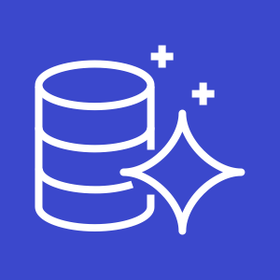

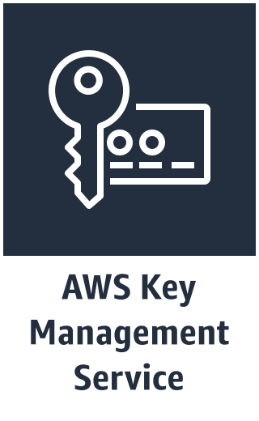

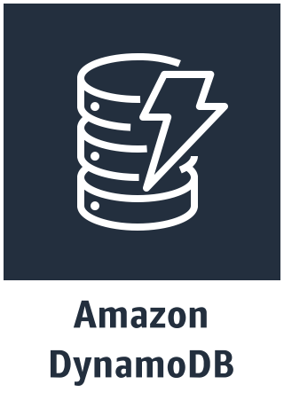

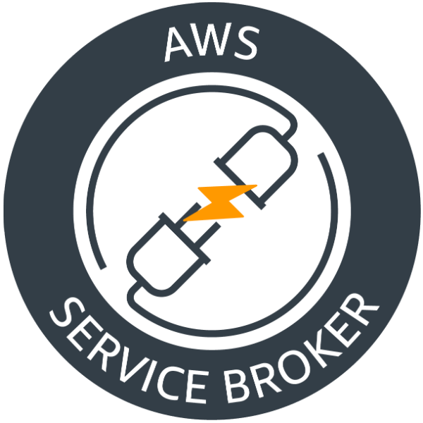




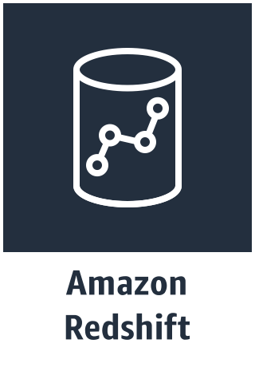
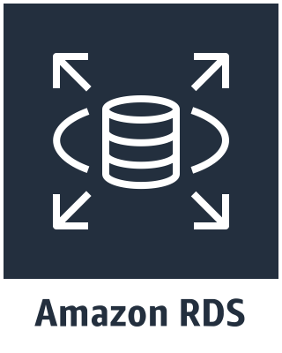

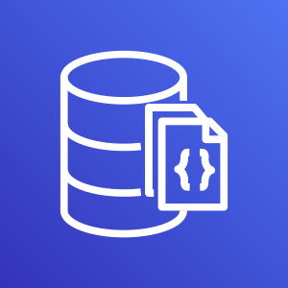


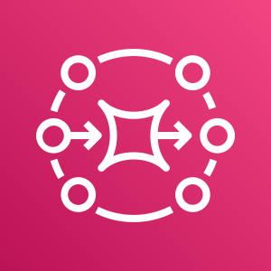
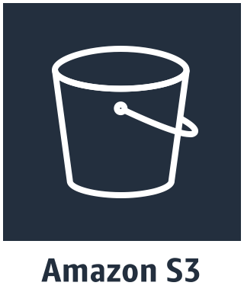

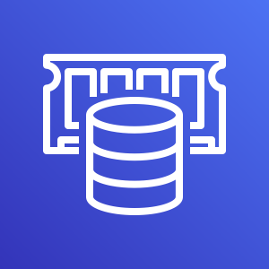

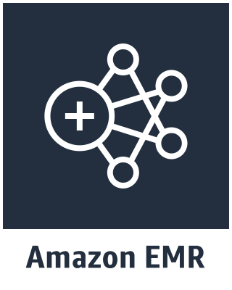
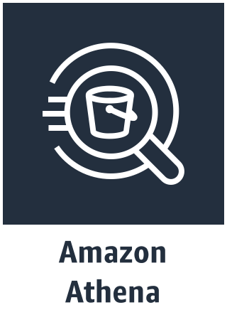
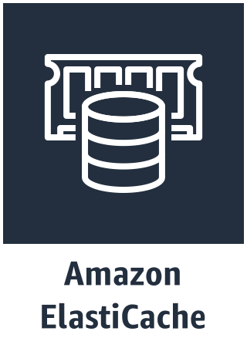
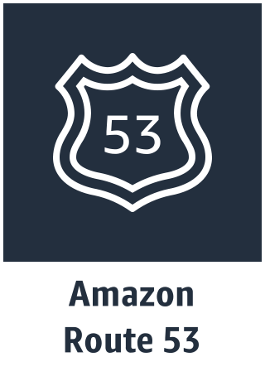



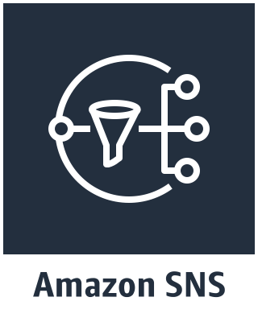

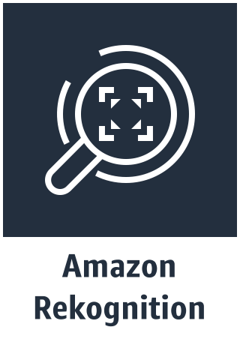
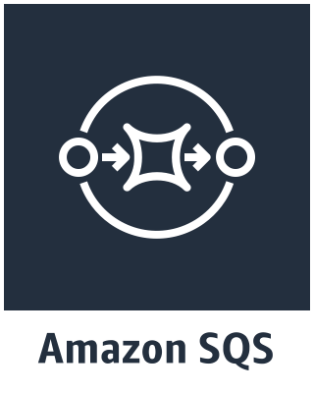



Amazon
Aurora mysql
Amazon Elasticsearch
Amazon
Aurora Postgres
Amazon RDS
MySql
Amazon RDS
Postgres
Amazon RDS
Oracle
Amazon RDS
MSSQL
Amazon MQ
Amazon Cognito
Amazon DocumentDB
Notes:
Red Hat and AWS working
Provision and expose AWS services from within OpenShift.
Bind services to applications
Securely store connection details within OpenShift Secrets.
Accelerating the adoption of AWS services and allowing teams to modernize applications taking advantage of highly available scalable native AWS services.

Slide 19
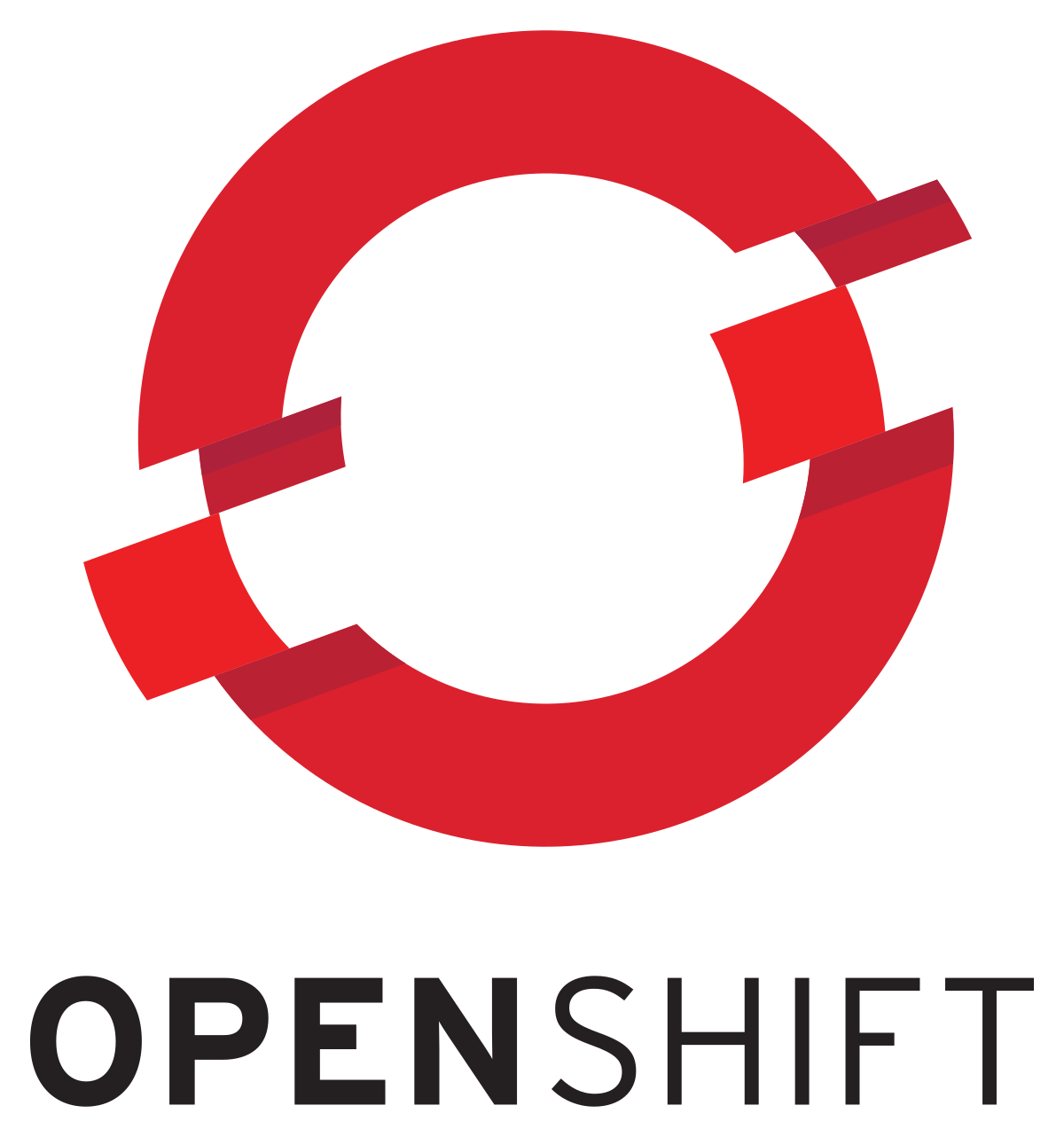

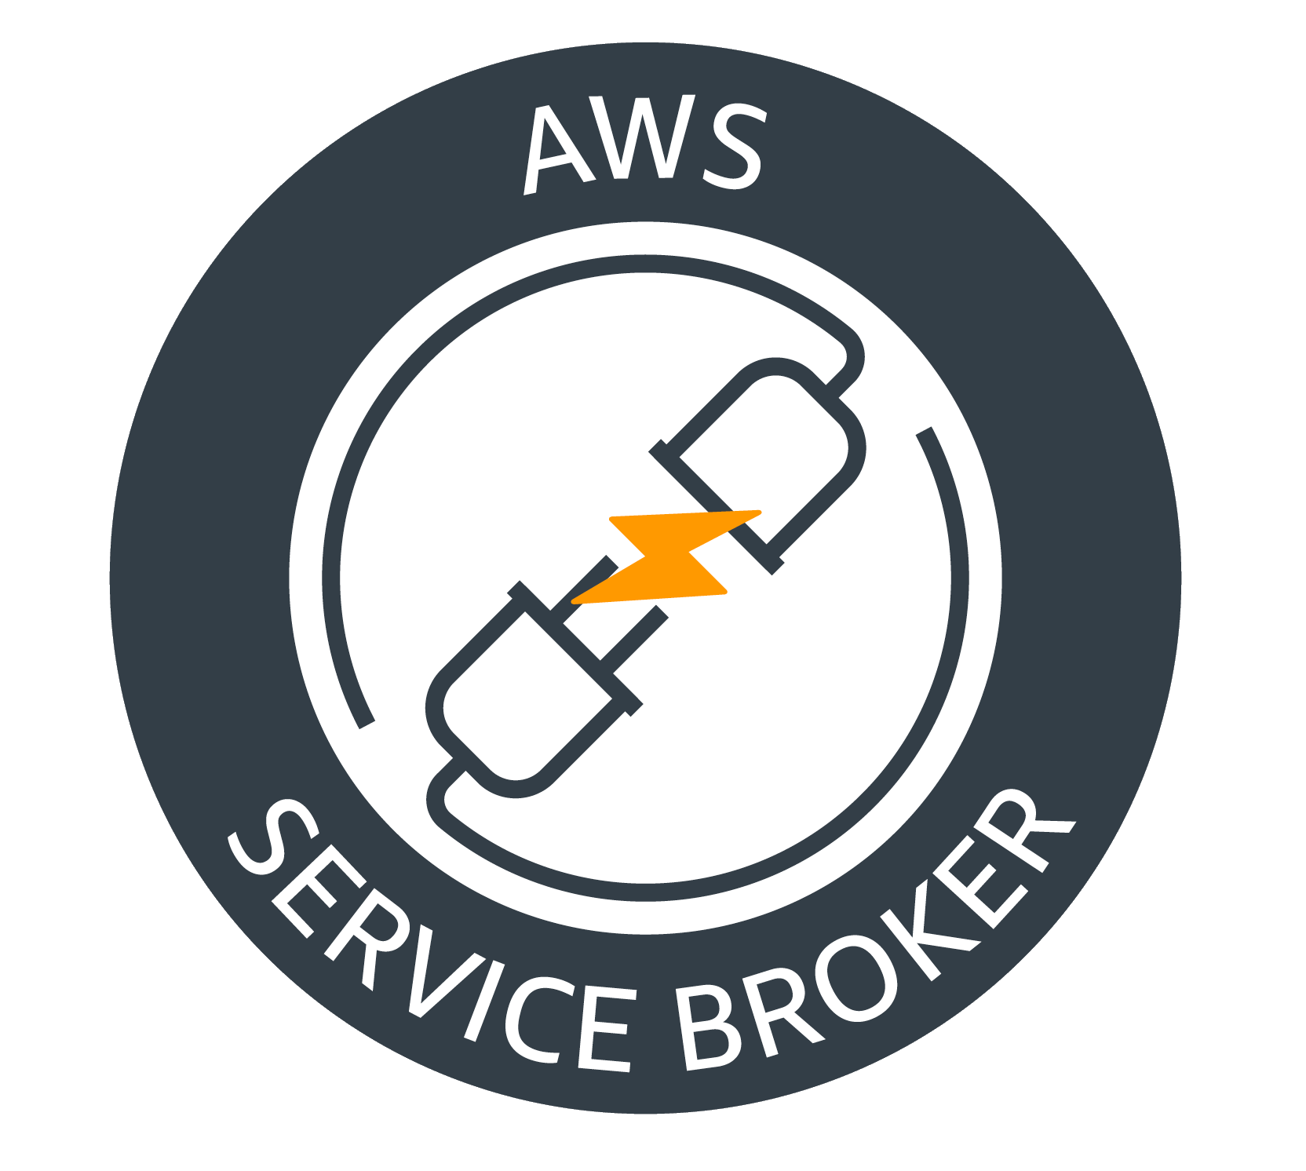


AWS Service Broker
Application
Catalog/Marketplace
Create
Provision
CreateStack
Create AWS Services
Application Created
Complete
CREATE_COMPLETE
AWS CloudFormation
Bind Service
Bind
DescribeStack/GetParameter
AWS CloudFormation
Secret
Bind Credentials
Connection Information
Application Platform
AWS KMS
AWS cloud
https://github.com/awslabs/aws-servicebroker/

Slide 20
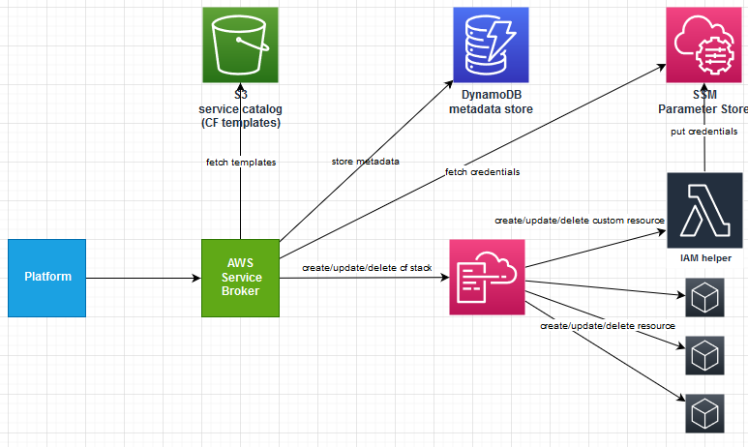

Slide 21
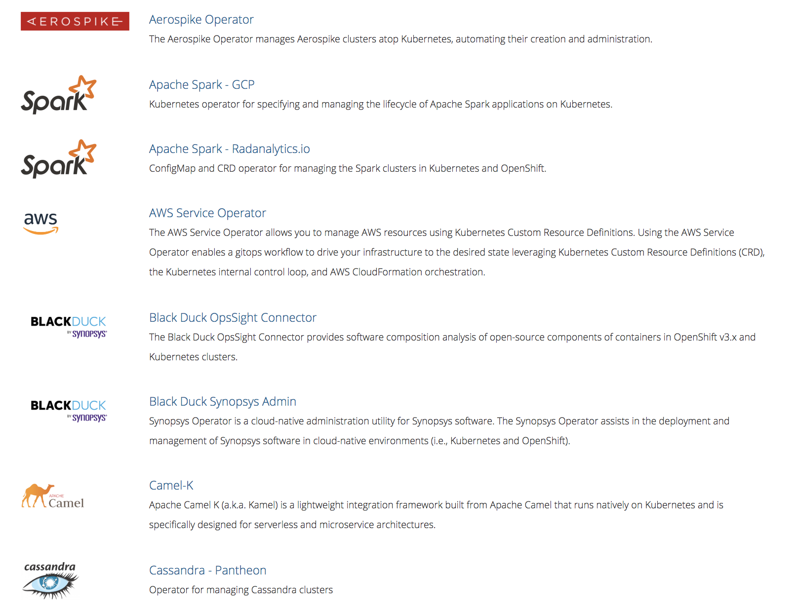
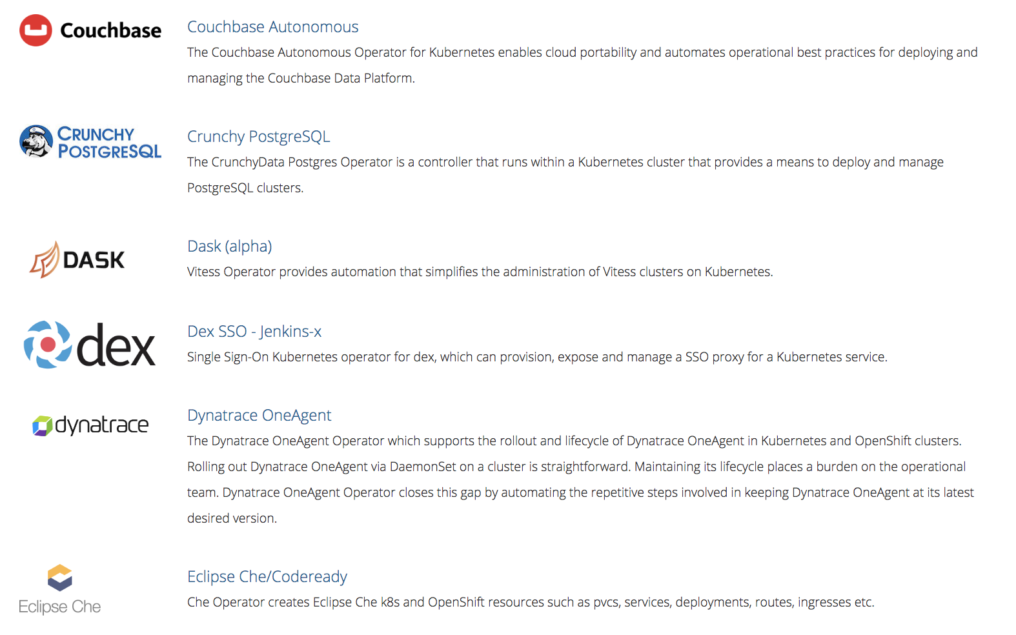
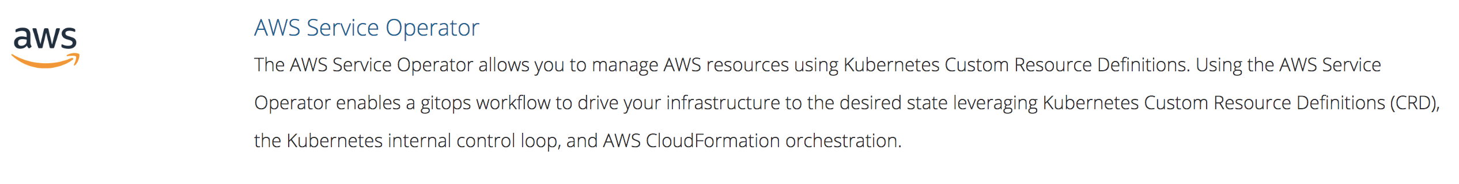
AWS Service Operator

Slide 22
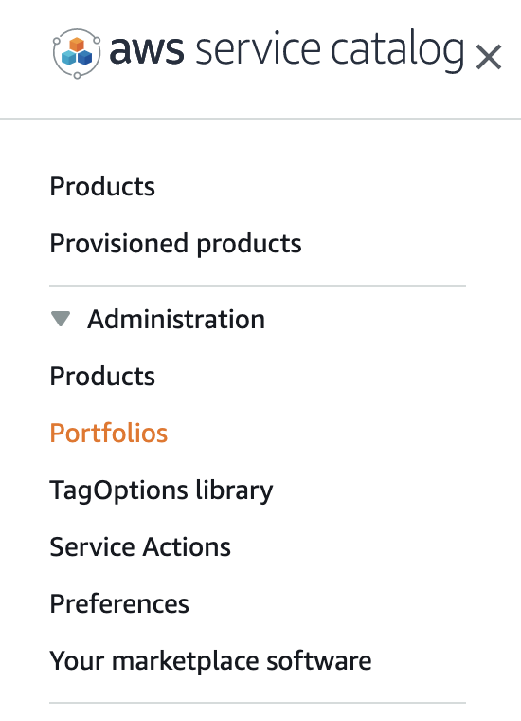
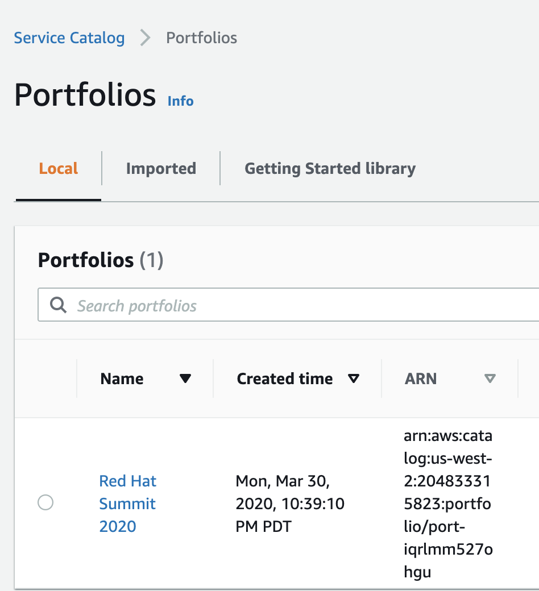
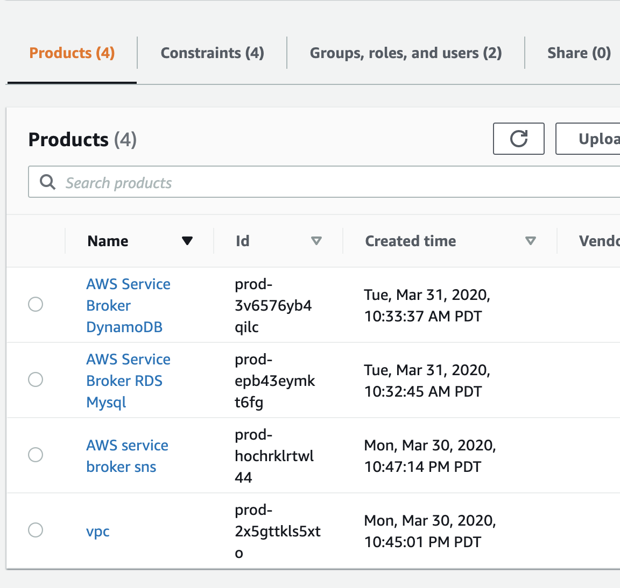
AWS service catalog admin

Slide 23
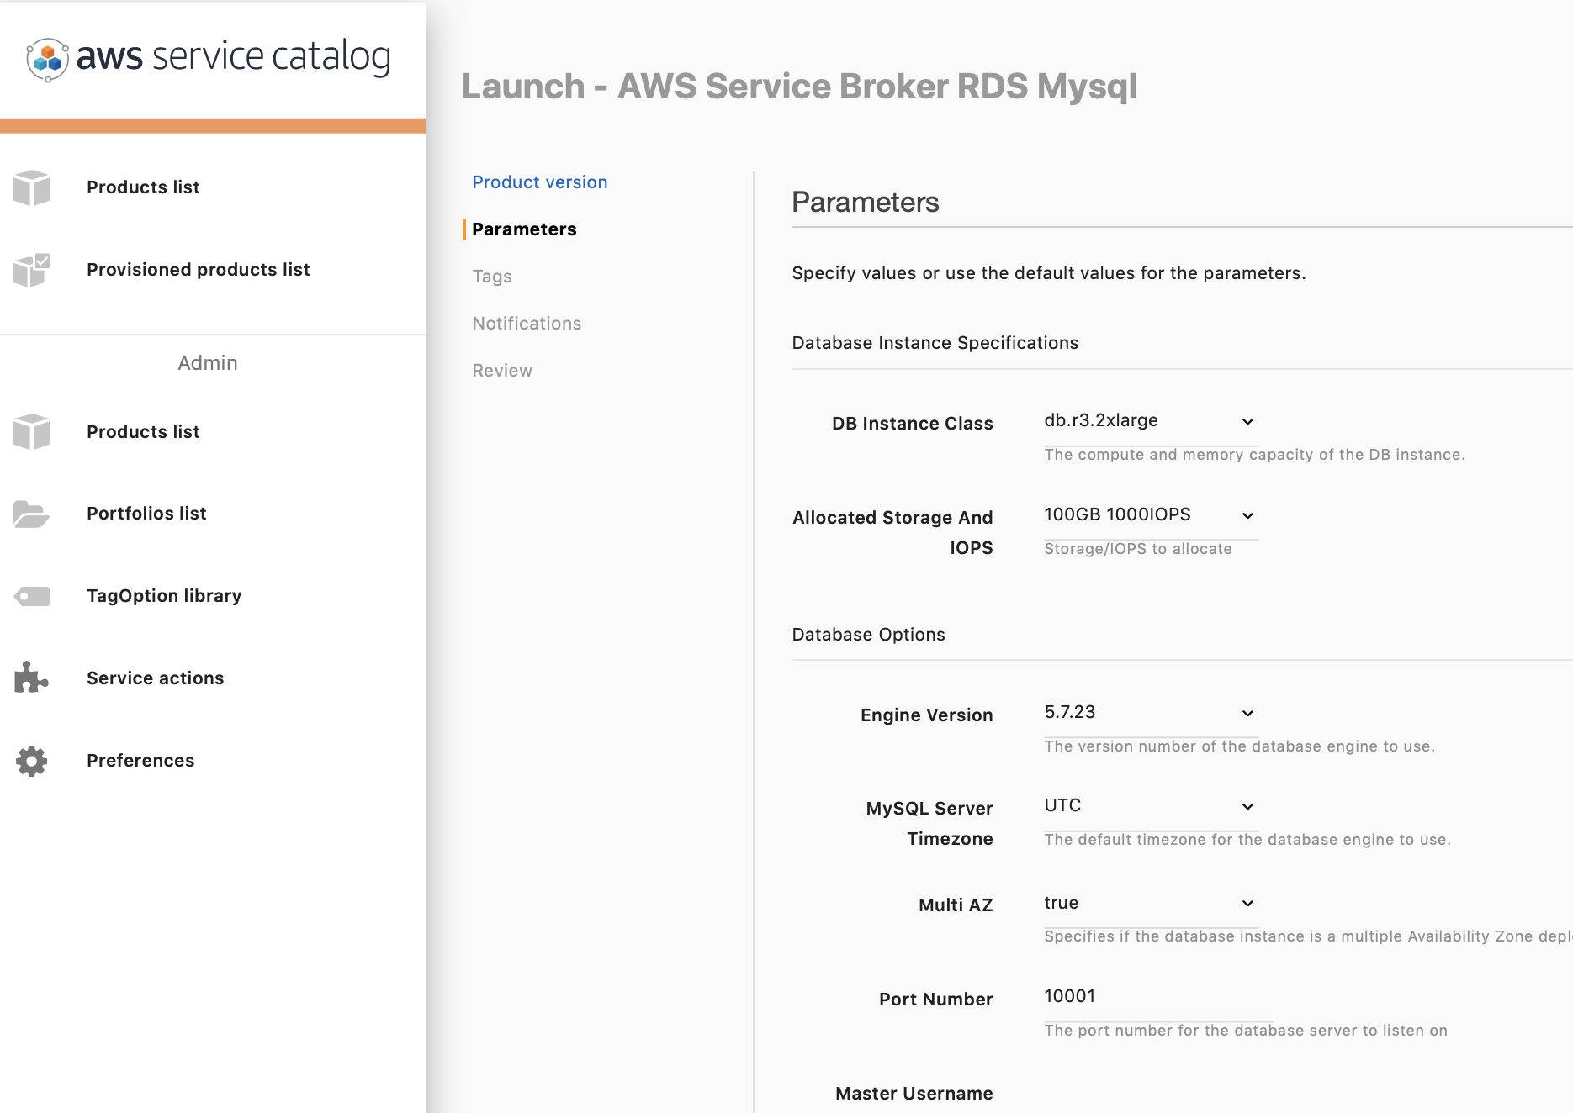
AWS service catalog end user
Launch product.
Collect stack outputs
Create OpenShift Secret
Bind to applications

Slide 24
OpenShift Architecture

Slide 25
Deploying OpenShift on AWS

Slide 26
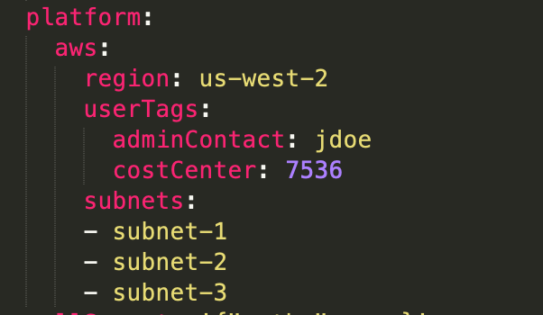
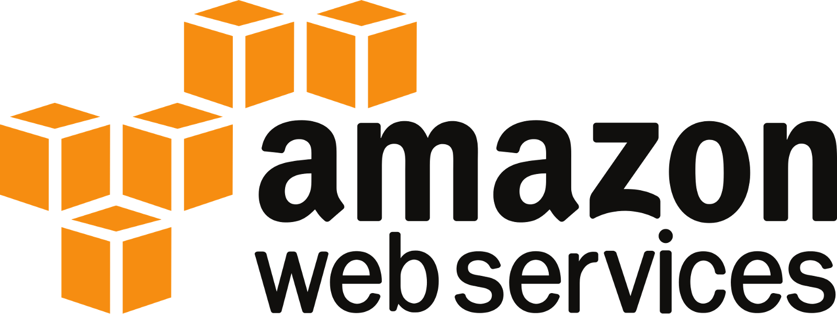
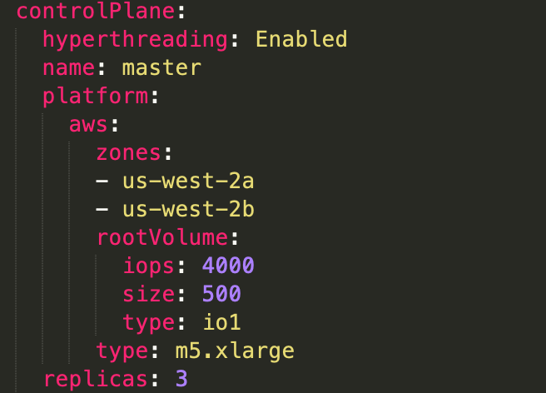
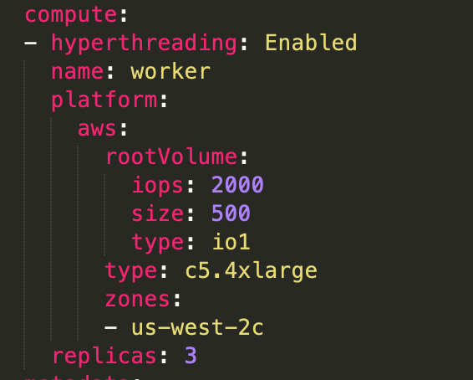
Installer change
Full Stack Automated
Pre-existing Infrastructure
Disconnected deployment available
Generally Available

Slide 27
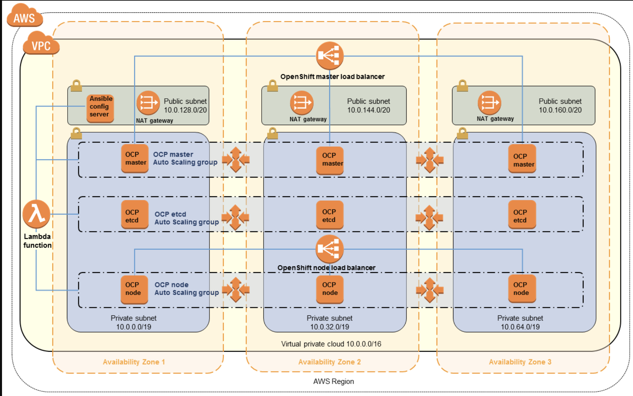
OpenShift Quick Start
https://aws.amazon.com/quickstart/architecture/openshift/

Slide 28
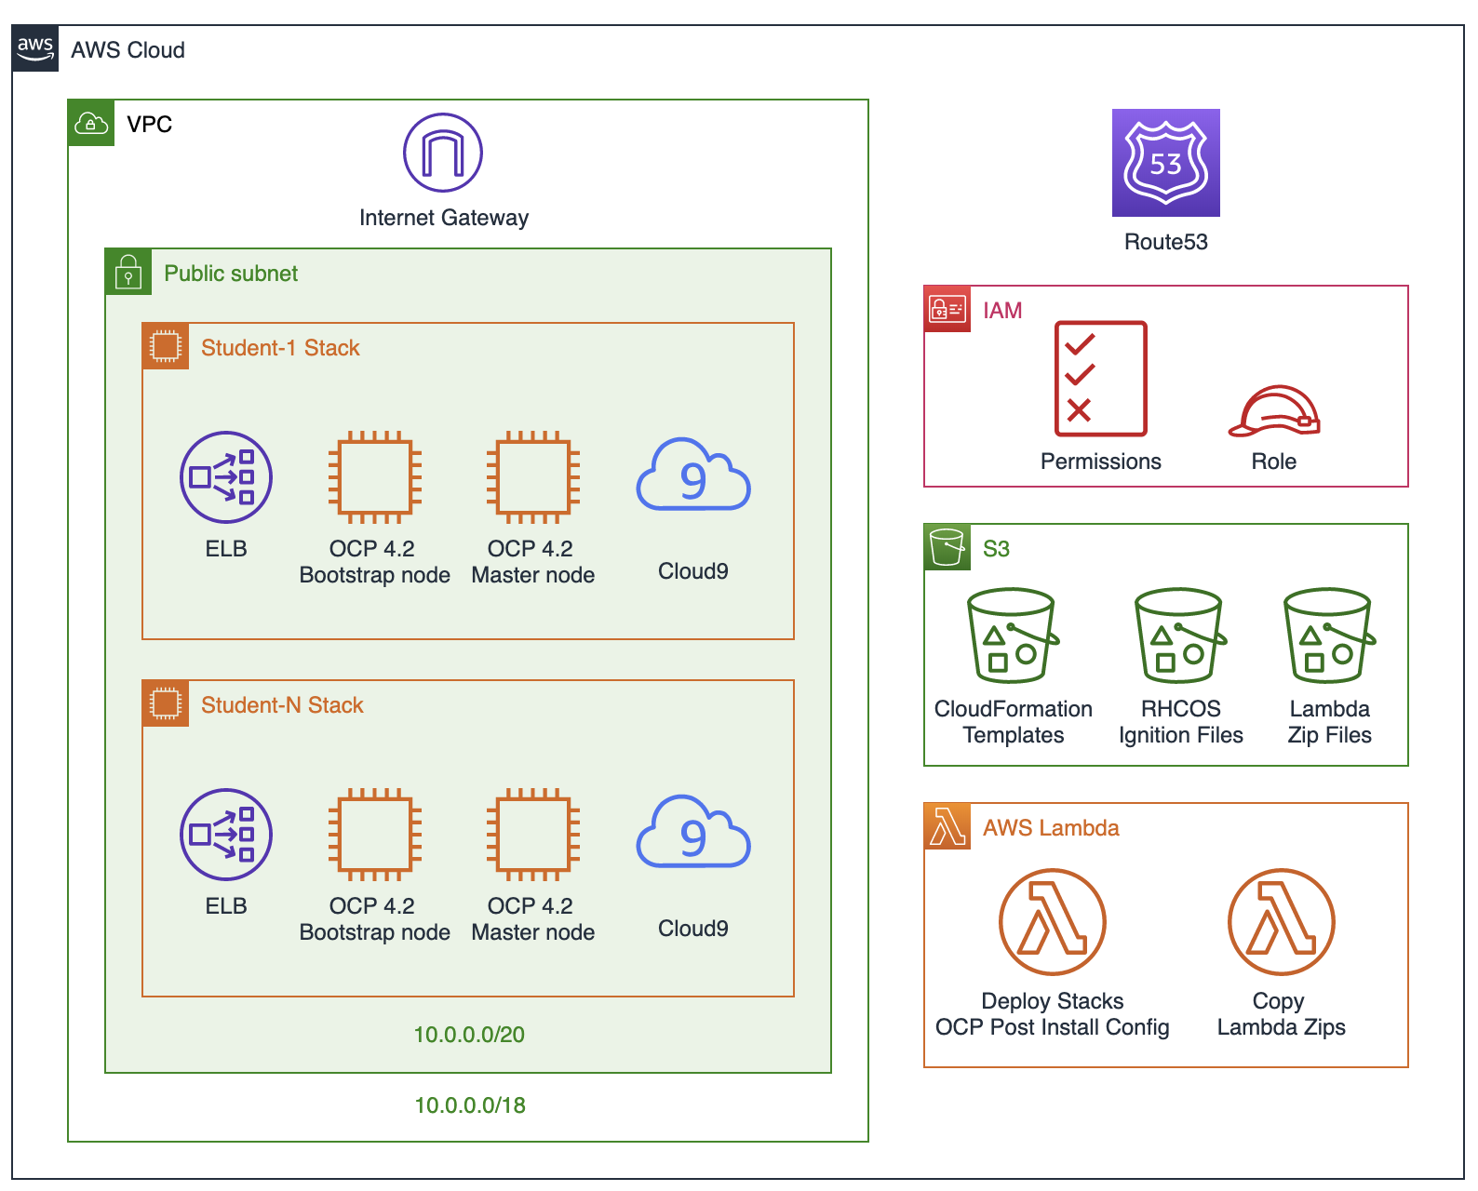
Automating ignition and install with AWS CloudFormation and Lambda.

Slide 29
Migrating to AWS

Slide 30
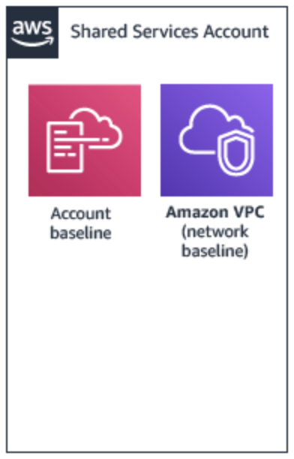
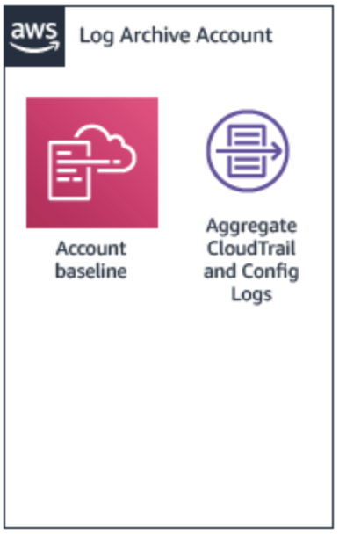
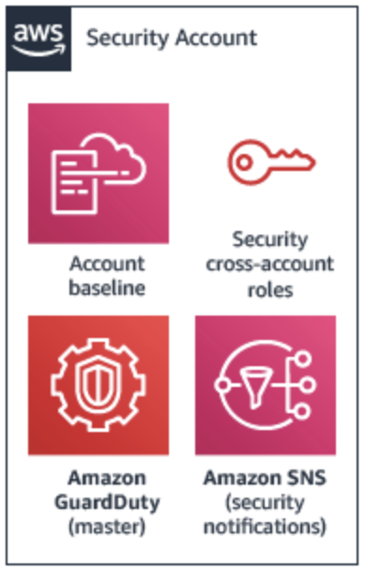
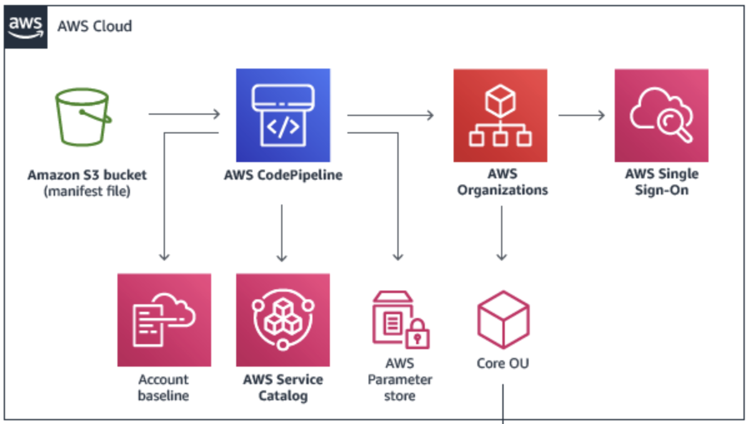
Rome was not built in a day… because it was build by romans?
Net new customers moving to AWS, need to build out infrastructure and management controls before they can migrate solutions, services and workloads.
https://aws.amazon.com/solutions/aws-landing-zone/

Slide 31
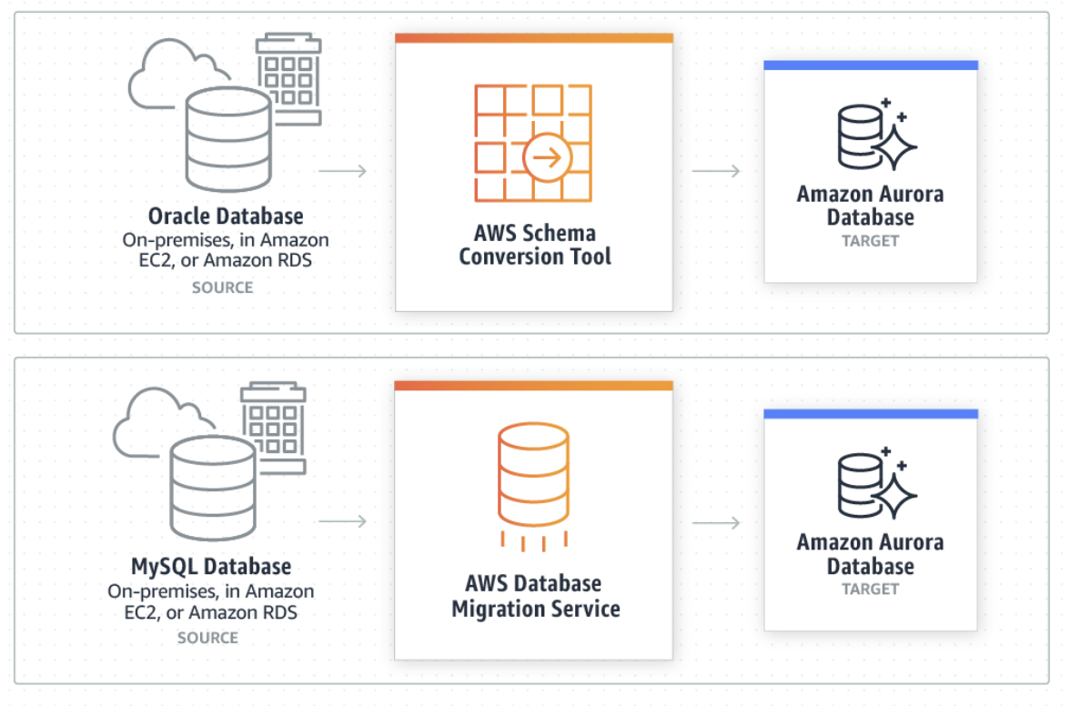
Not good enough!
How to get the data where we need it.
Migration assessments
Code conversion
Heterogeneous replication
Continuous replication
More than 200 000 databases migrated to date.

Slide 32
Cost management

Slide 33
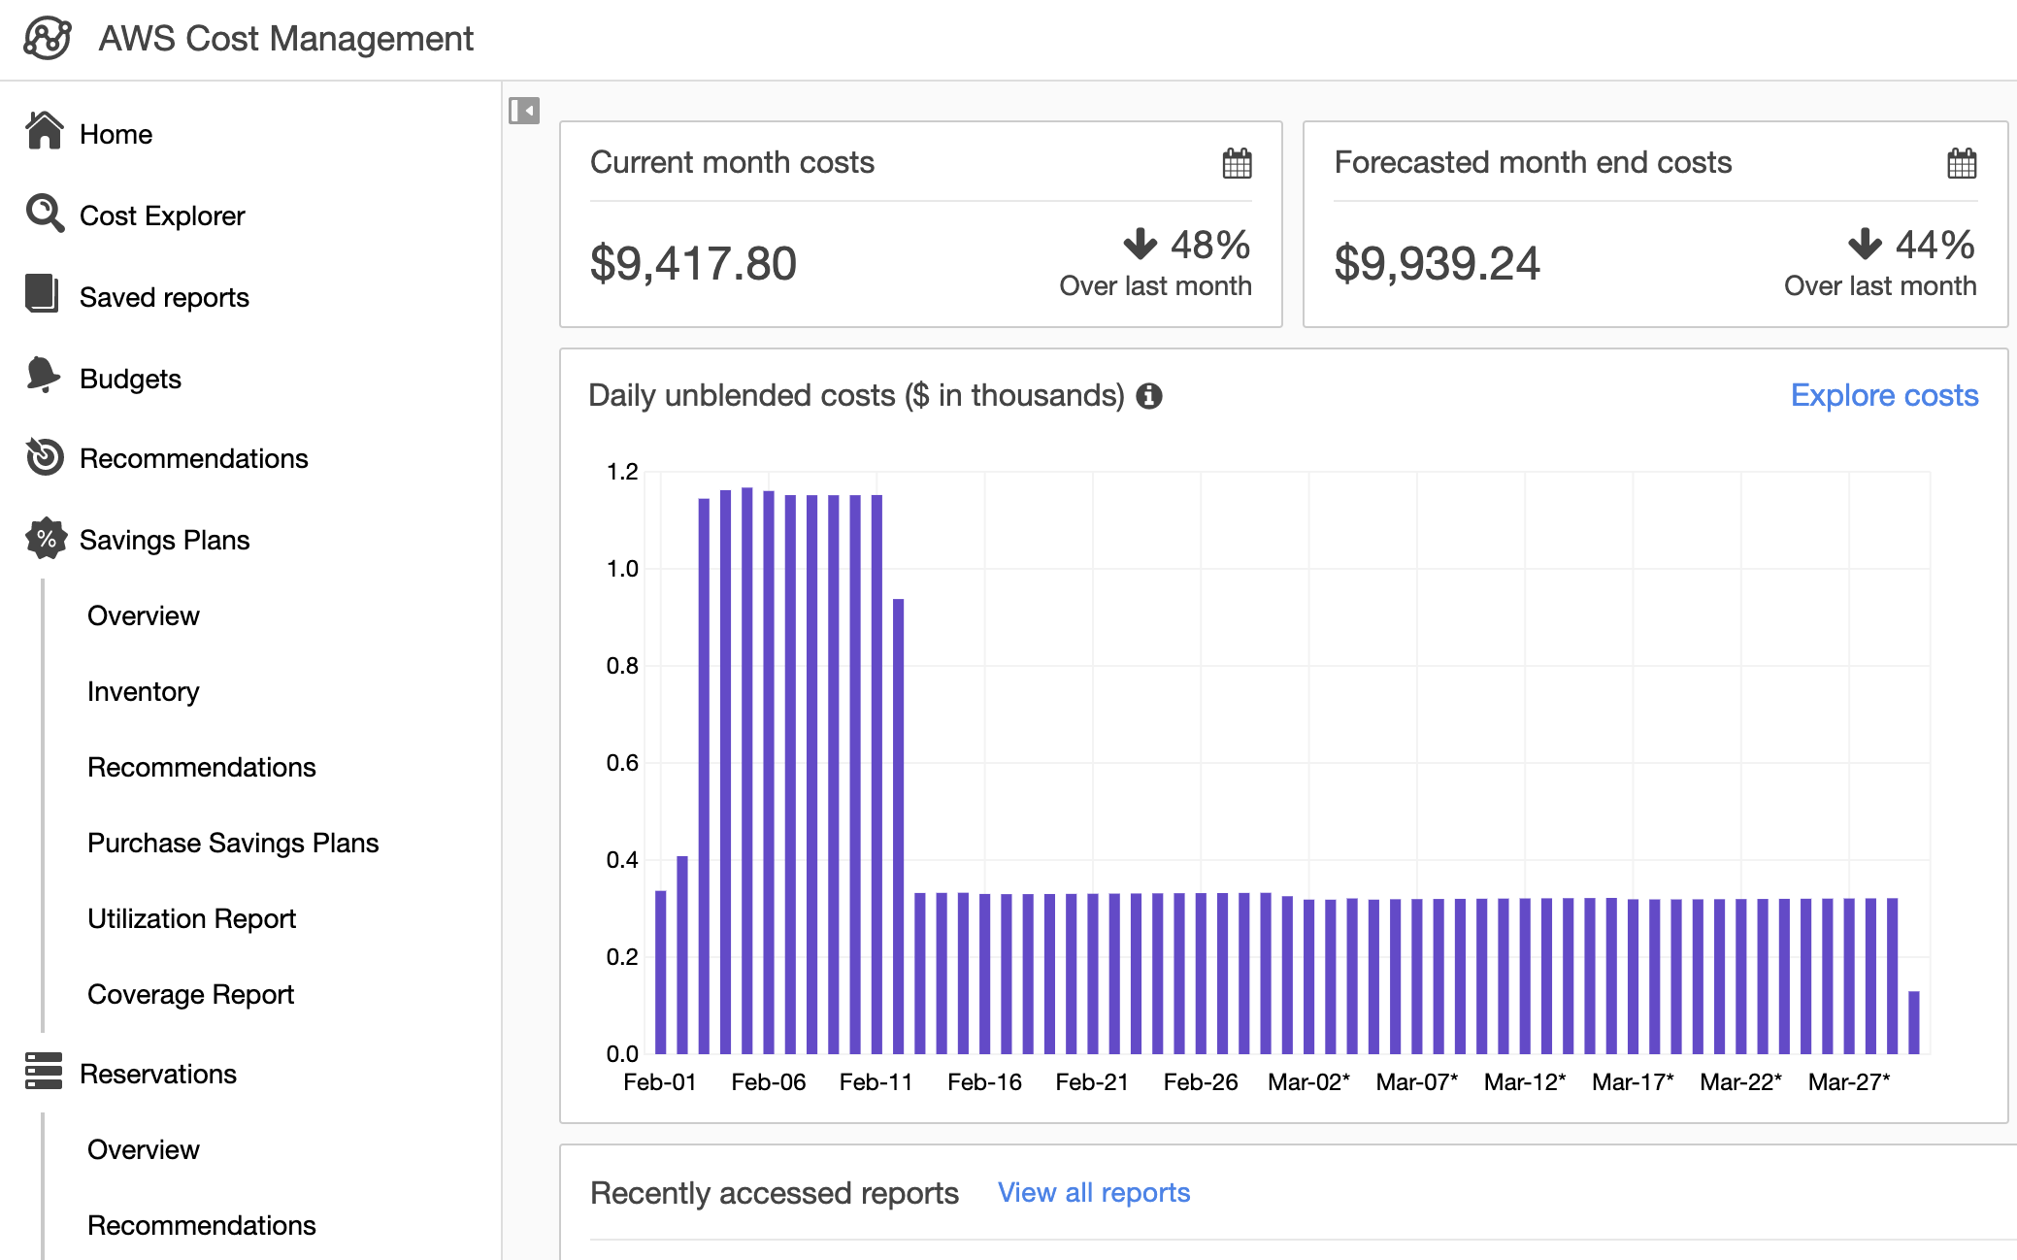

Slide 34
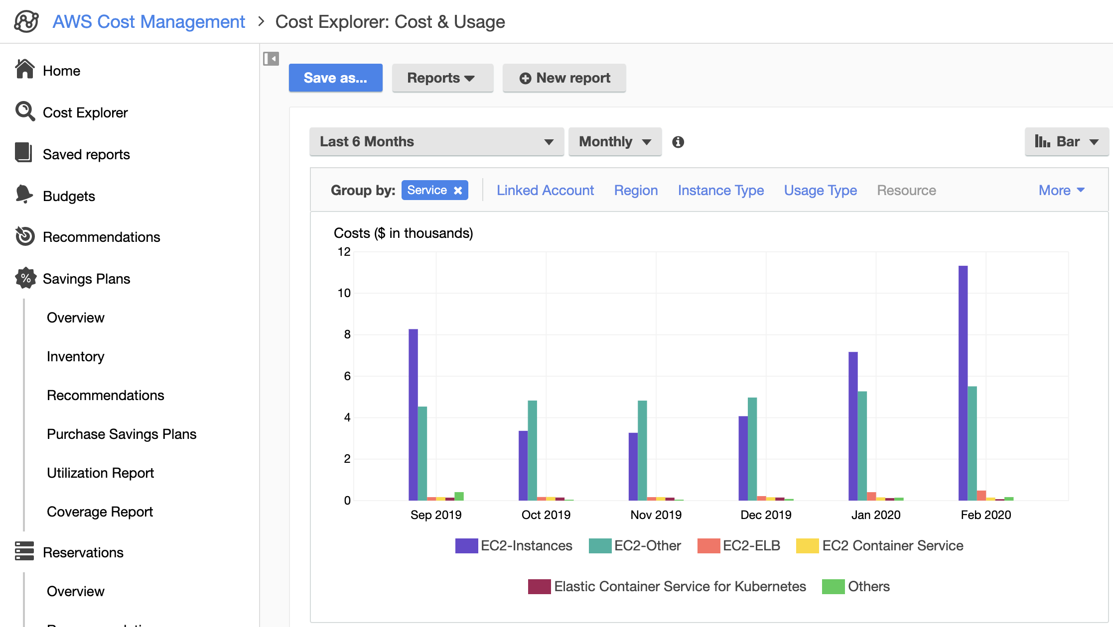

Slide 35
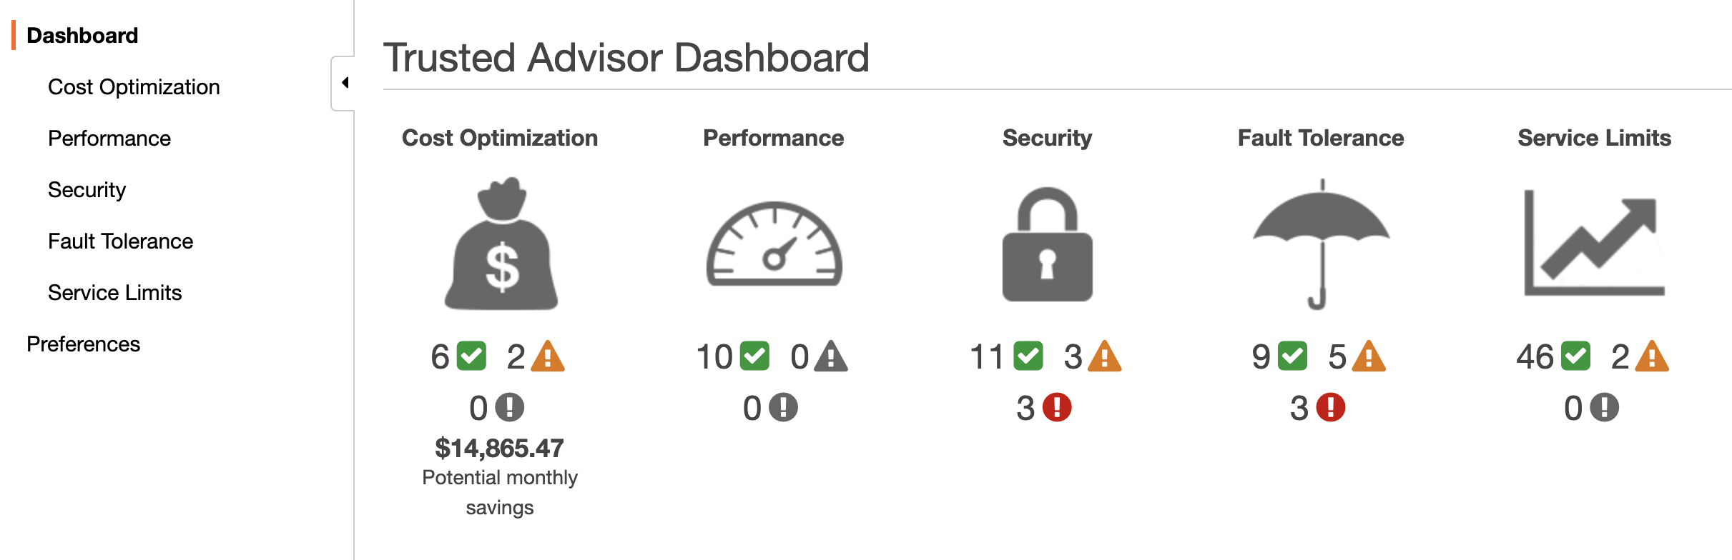
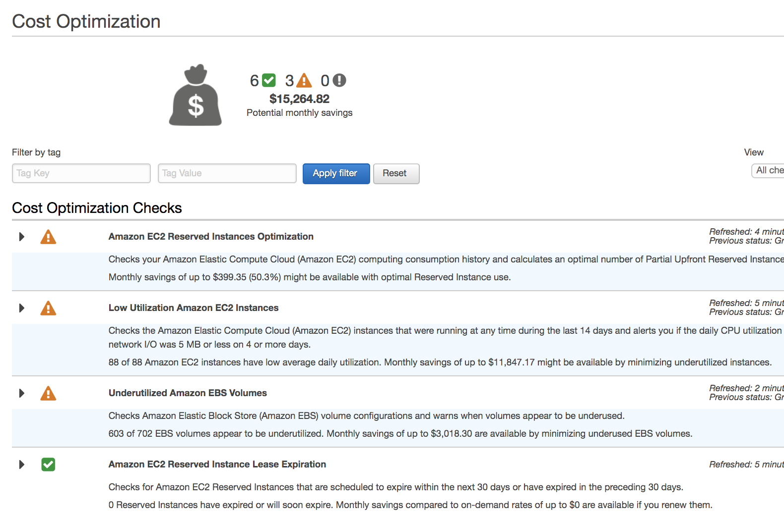
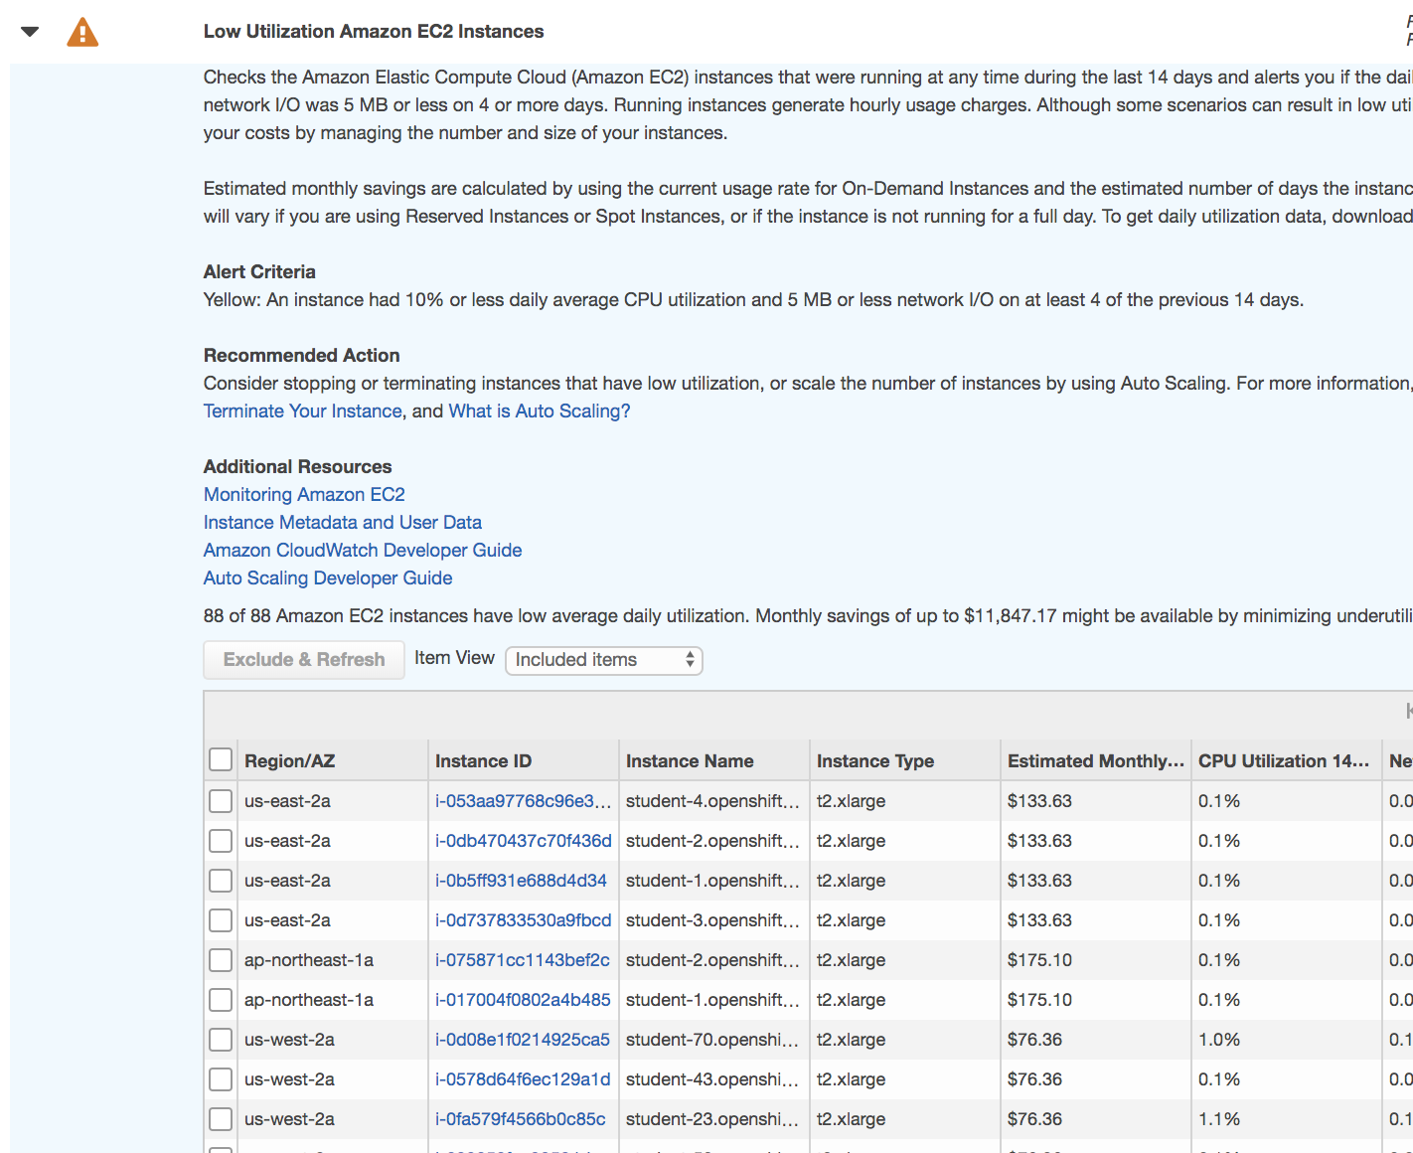

Slide 36
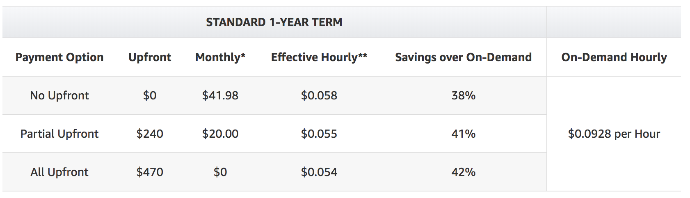

Reserved instances

Slide 37
Comparing apples with apples…

Slide 38
OpenShift vs ECS and EKS???

Slide 39
Two starting points: You can not simply compare OpenShift to ECS or EKS. OpenShift should not be referred to as Enterprise Kubernettes! OpenShift is a collection of open source projects and services combined into a powerful turn key solution it caters for far more than Kubernettes hence referring to OpenShift a Enterprise Kubernettes sets the incorrect expectation. This will often result in unnecessary discussions regard OpenShift vs ( pick your flavor of Kubernettes) Like wise OpenShift caters for more than is simply provided by AWS ECS or EKS. It would be more accurate and meaningful to compare OpenShift to a collection of AWS services or to compare certain layers of OpenShift to ECS and EKS.

Slide 40
Mapping OpenShift features to AWS services
Container image repo - this is not part of ECS or EKS, it would map to ECR. Pipeline and build automation - this is not part of ECS or EKS , it would map to code pipe line and code build. Container run time and orchestration - this would map to ECS and EKS (more or less) Build in monitoring - this would map to Cloud Trail logs, Cloud watch, Elastic search, Quick Sight. Single Sign on - this would map to IAM with federation to Microsoft AD. OpenShift operator catalog - no direct AWS mapping* RHEL or CoreOS - * Service mesh - this would map to AWS service Mesh Knative - this would map to containers running on EC2 t2.nano more than to Lambda????? Is it really server less? OpenShift container storage - this would map to EFS Machine sets - this would map to Kubernettes autoscaler to AWS autoscaling groups Role based access control - this would map to AWS IAM + predefined IAM policies Security context constraints - this would map to AWS Config + rules
Hybrid use case - map to Outpost + ECS /EKS but only for on premises.

Slide 41
Comparison Summary
In summary it is not possible to compare OpenShift to ECS or EKS, it would be more accurate to compare the functions a customer is using of OpenShift and compare these to the collection of related AWS services.
i.e a customer may not be using the pipe line or build process of OpenShift as they have an existing CICD solution, or a customer may not be using the build in monitoring of OpenShift and using their own 3rd party solutions.

Slide 42
ECS and EKS differentiators :
Significant lower per cluster cost (no OS or software subscription cost, one would need to consider all AWS services used)
Managed control plane - customers using OCP would have to self manage the OpenShift control plane ( master and infrastructure nodes. This is less a concern for managed versions of OpenShift)
Fargate integration - allows for managed application or worker nodes.
AWS console and API integration –
AWS billing integration -

